Slide 1
IMPLEMENTATION OF INFORMATION SYSTEMS
Total Hour:9hrs
Presented by
Er.Harendra Bikram Shah
Lecturer
Department of BE Computer

Slide 2
OUTLINES
6.1.Change Management
6.2.Critical Success Factors
6.3.Advanced Balanced Scorecard
Advanced Strategic foundation development
Advanced objective and Strategy map development
Advanced performance management
Implementation and Visualization
Strategic initiative prioritization and management
Advanced scorecard alignment and cascading Dashboard

Slide 3
INTRODUCTION
Systems implementation is the process of:
defining how the information system should be built (i.e., physical system design),
ensuring that the information system is operational and used,
ensuring that the information system meets quality standard (i.e., quality assurance).

Slide 4
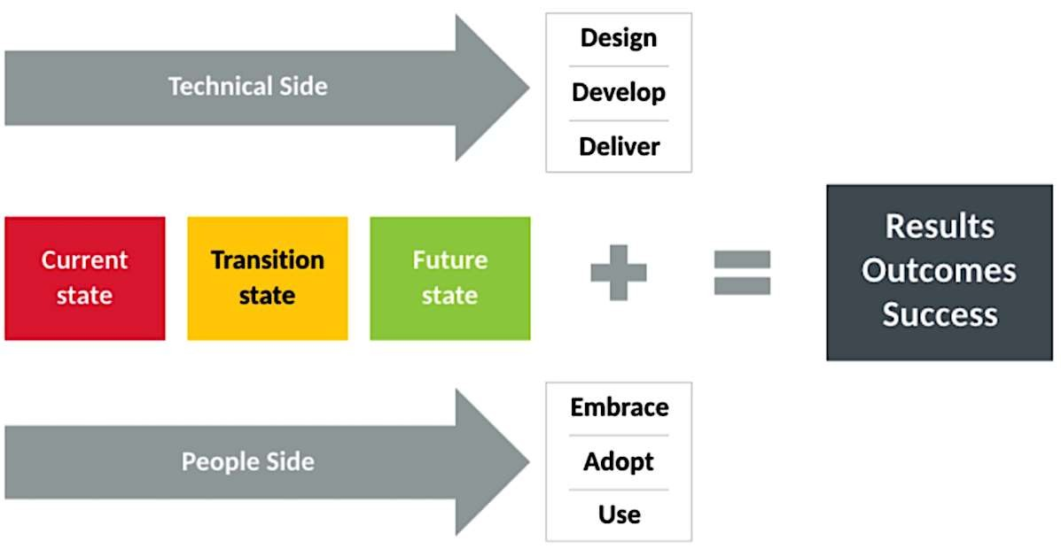
Change Management
Change management is the process, tools and techniques to manage the people side of change to achieve the required business outcome.
✓Change management is an approach to transitioning individuals, teams, and organizations to a desired future state.
✓Change management is a method for reducing and managing resistance
✓Change management is not a stand-alone technique for improving organizational performance.

Slide 5
What is (not) Change Management?
Change management is not a stand-alone process for designing a business solution.
Change management is not a process improvement method.
Change management is not a stand-alone technique for improving organizational performance.

Slide 6
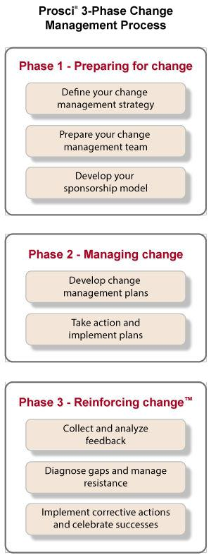
Steps for an Effective Change Management Process

Slide 7
Types of change within a business
Common types of organizational change include:
Developmental change: include any improvement on existing operations within a company.
Transitional change: happen when a business makes a transition into a new state of being.
Transformational change: This is the most drastic form of change within a business and is when a company decides to completely revise its current way of doing things.

Slide 8
Why Change Management
Change is always happening in organization.
Every day, new initiatives and projects are launched.
There is a common denominator for achieving the intended outcomes of initiative people.
Approach driving adoption and usage so that initiatives deliver expected results and outcomes.

Slide 9
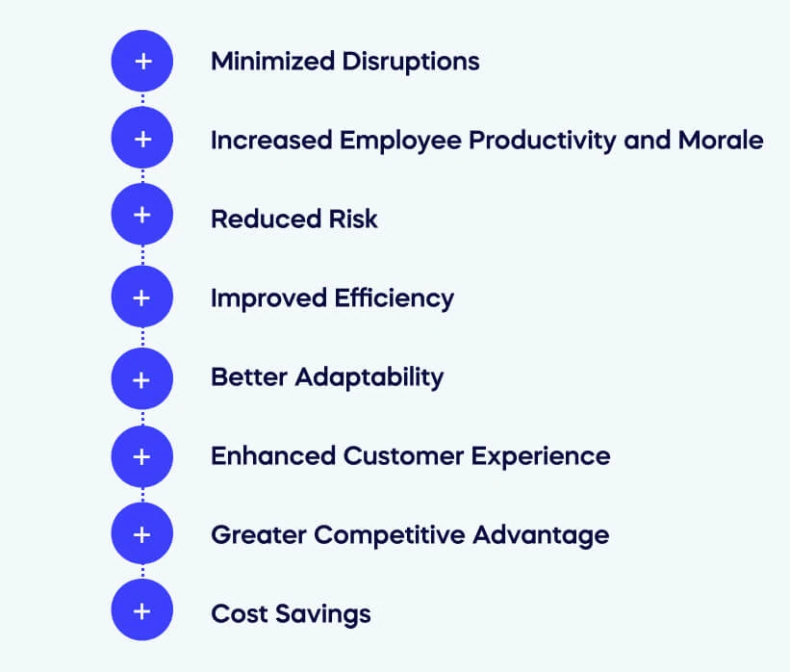
Benefits of Change Management

Slide 10
Why Change Management is important
External factors
Making ideas succeed
Enabling cross-functional changes
Engaging people with the change process
Preparing for organizational transition
Improving performance and productivity
Reducing costs

Slide 11
Critical Success Factors[CSF]
The concept of "success factors" was developed by D. Ronald Daniel of McKinsey & Company in 1961.
The process was refined into “critical success factors” by John F. Rockart between 1979 and 1981.
CSF is a management term for an element that is necessary for an organization or project to achieve its mission.
A CSF is a critical factor or activity required for ensuring the success of a company or an organization.
A critical success factor (CSF) is a concept used in business and project management to denote an element that is essential for the success of an organization or project.
For example: Understanding of Market, Marketing trends, Decision Making.

Slide 12
Types of Critical Success Factor:
There are four basic types of CSF’s, they are: ü Industry CSF’s resulting from specific industry characteristics; ü Strategy CSF’s resulting from the chosen competitive strategy of the business; ü Environmental CSF’s resulting from economic or technological changes; ü Temporal CSF’s resulting from internal organizational needs and changes.
CSFs are classified into two category:
Primary
Within Time
Within Cost
Within Quality Limits
Accepted by the Customer
Secondary
Follow-on work from this customer
Using the customer’s name as a reference on your literature
With minimum or mutually agreed upon scope changes
Without distributing the main flow of work
Without changing the corporate culture
Without violating safety requirements
Providing efficiency and effectiveness of operations

Slide 13
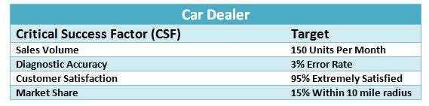
Need of Critical Success Factor:
Focus on Key Objectives:
Prioritization of Efforts:
Measurement and Evaluation:
Risk Management:
Strategic Alignment:
Competitive Advantage:
Continuous Improvement:
Example of CSF

Slide 14
Six Steps to Identify and Develop Your CSFs
To identify and develop CSFs for your organization, follow these six steps:
Establish your organization's mission and strategic goals .
For each strategic goal, ask yourself, "Success in what area of business or project activity is essential to achieve this goal?" The answers to the question are your potential (or "candidate") CSFs.
Evaluate the list of candidate CSFs to identify the ones that are truly essential for achieving goals.
Work out how you will monitor and measure each of your CSFs.
Clearly communicate your CSFs to those responsible for delivering them and to rest of the business.
Continually monitor and reassess your CSFs to make sure that you stay on track toward your goals.

Slide 15
Advanced Balanced Scorecard

Slide 16
THANK YOU

